Slide 2
Iteratively Develop Microservices With Speed On Kubernetes
Lisa Guthrie

Slide 3
Kubernetes is great for deploying, running, and managing cloud-native applications…
…but what about building those applications?

Slide 4
Collaborate efficiently with Azure Dev Spaces
Share an AKS cluster for team development
Onboard new team members with minimal machine setup
Test code end-to-end without replicating or simulating dependencies

Slide 5
Fast, iterative development for cloud native apps
Light yellow
Iterate fast, directly in Azure
AKS
with Dev Spaces
Yellow (Primary brand color)
Light blue
Red (Primary accent color)
Blue (Primary brand color)
Dark red
Mid blue
Commit code
Deploy
Light orange
Edit content (html, css, cshtml)
Update file directly in running container
1
2
Dark blue
Edit server code
Restart node service, .NET build/run
Orange (Primary brand color)
Edit Dockerfile, Helm chart, package.json...
SCC => CI/CD
Rebuild container image, redeploy

Slide 6
Collaborate within a development team
http://myapp.aksapps.io
WebFrontEnd
MyWebApi (Susie’s version)
EmployeeSearch
MyWebApi

Slide 7

Collaborate within a development team
http://myapp.aksapps.io
WebFrontEnd
EmployeeSearch
MyWebApi
http://susie.s.myapp.aksapps.io
EmployeeSearch (Susie’s version)
Susie Walter

Slide 8
Demo

Slide 9
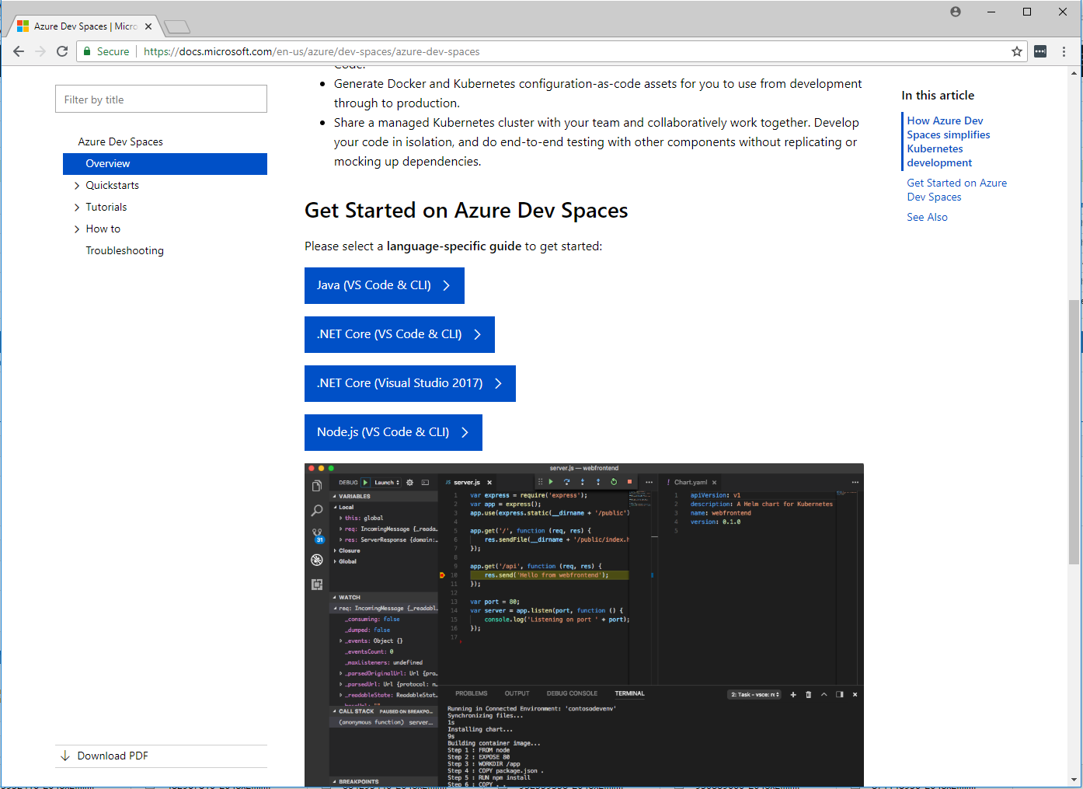

Resources
Get started with Azure Dev Spaces
http://aka.ms/get-azds

